Slide 1

WEEK 2
Game pitch & Github

Slide 2
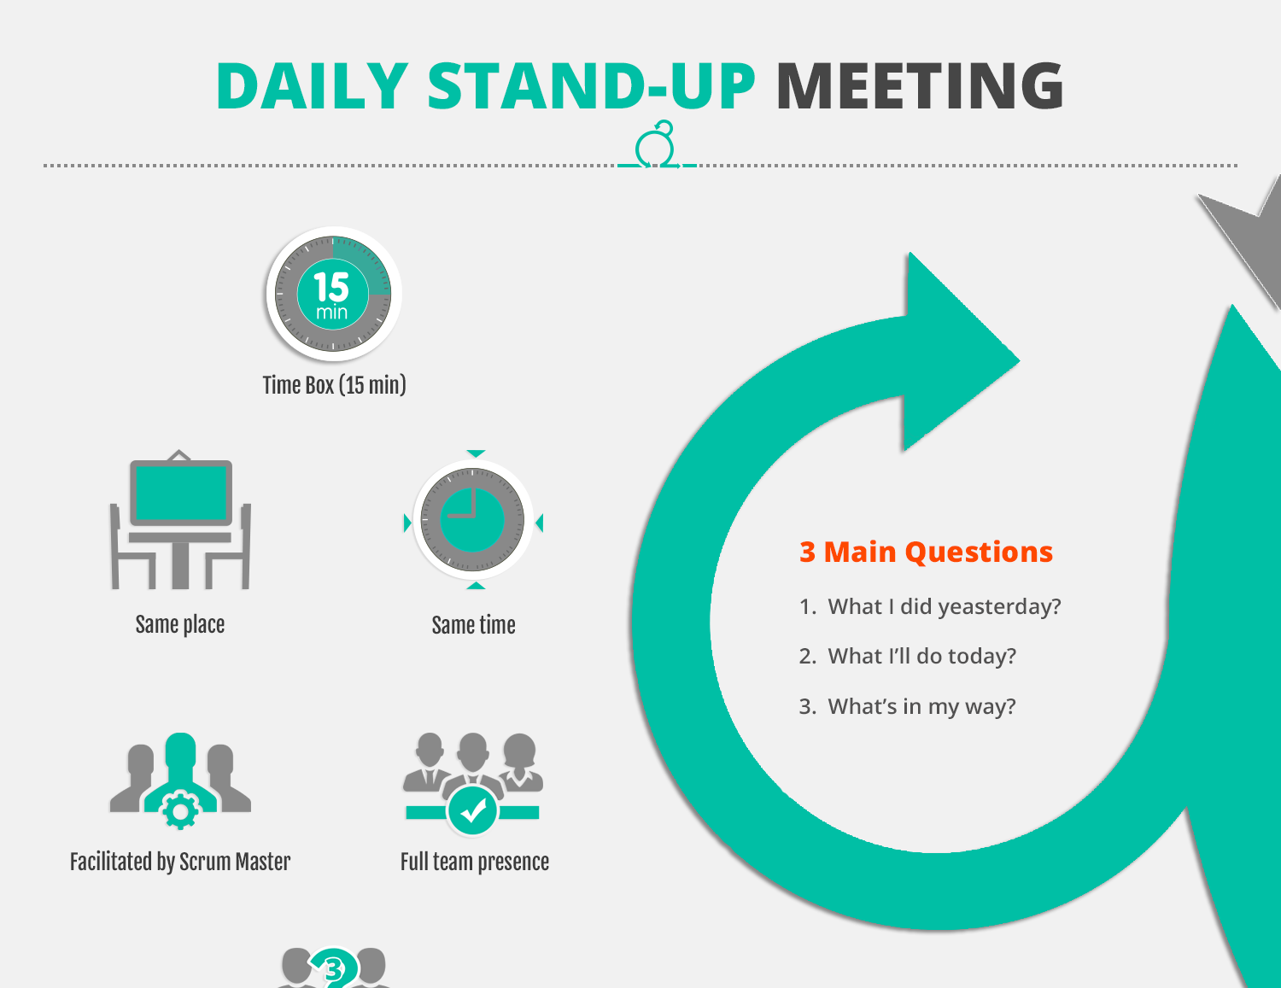
Scrum
What I did last week?
What I'll do this week?
What's in my way?

Slide 3
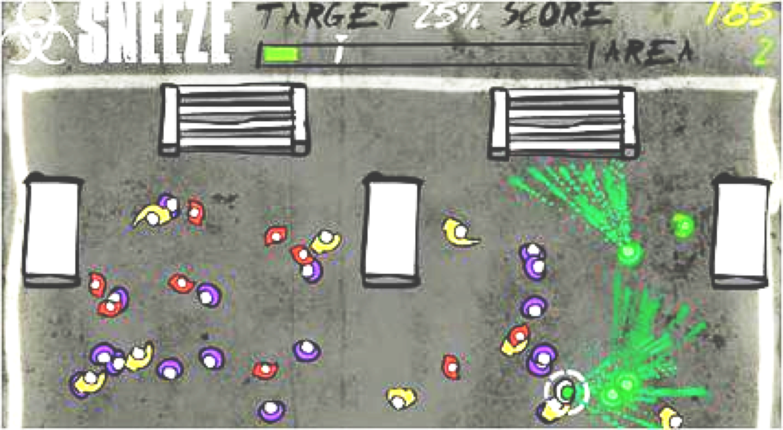
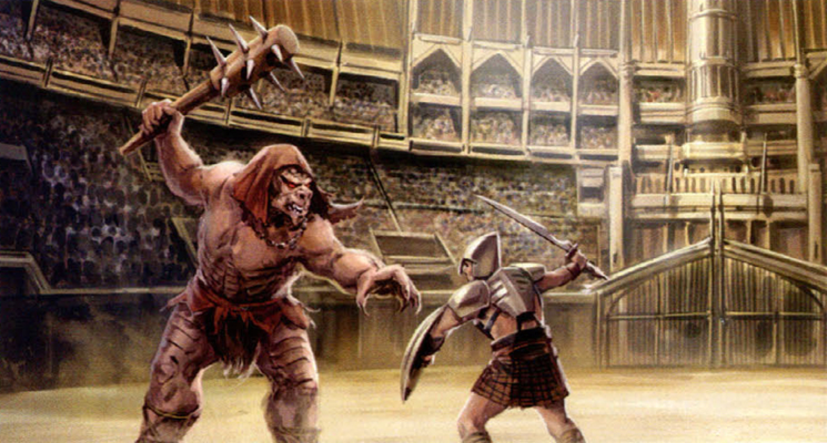

Your game
The Best Team: Sneeze Game
Black Fox Games: Arena Man
Team Lost: Abscond Runners

Slide 4
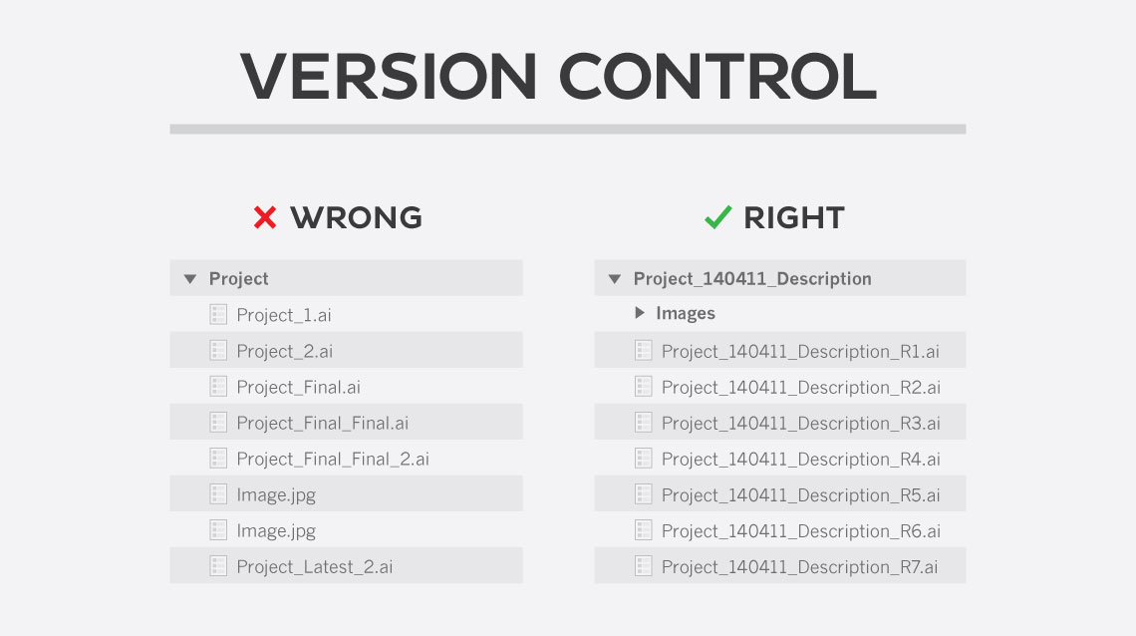
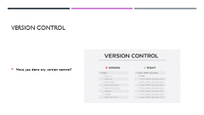
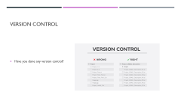
Version Control
Have you done any version control?

Slide 5
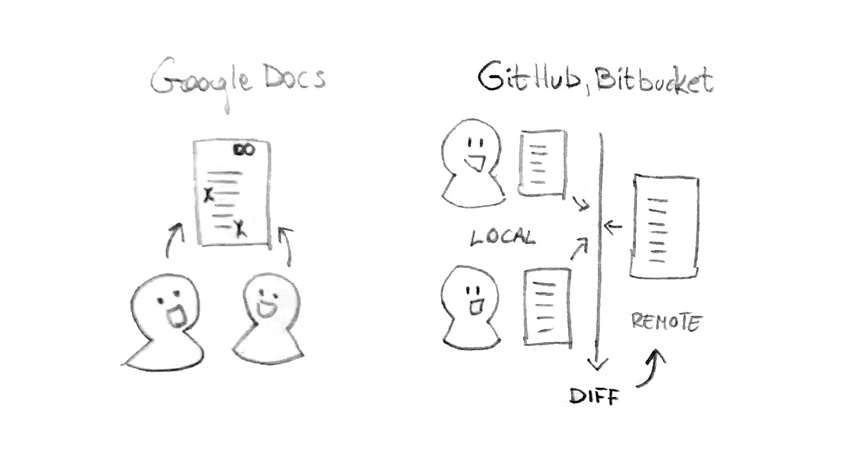
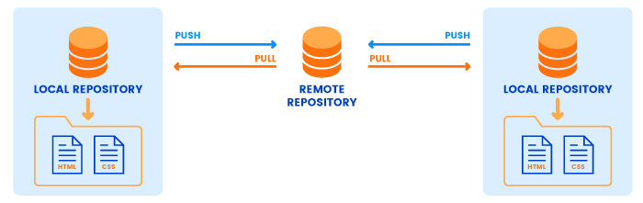
Github

Slide 6
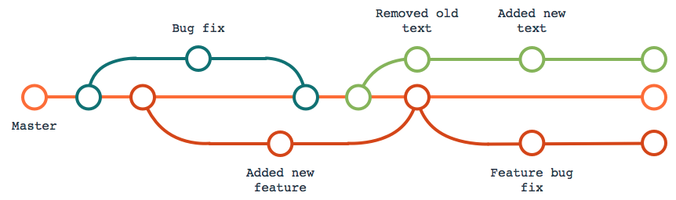
Branch and merge

Slide 7
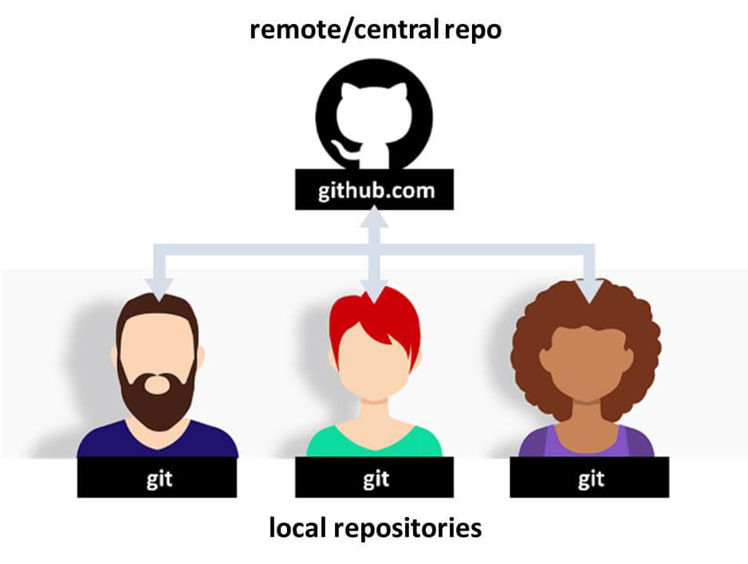
Local vs remote

Slide 8
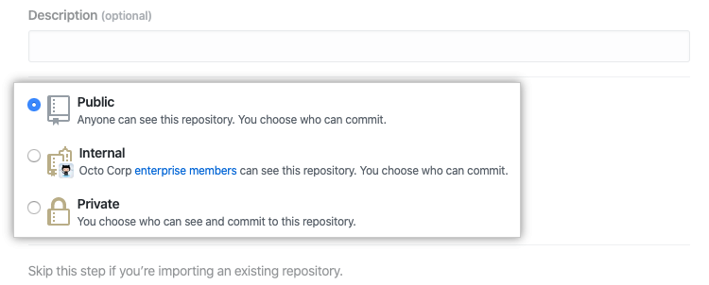
Public vs private

Slide 9
Open Source
WHY?
Improve overall product
Get help from credible sources
Increase transparency and ownership
Reduce duplication of work
Open Source Guide
Open Source Guides | Learn how to launch and grow your project.
Unity Resources on GitHub

Slide 10
Github Desktop: HANDS-ON
Open-Source Collaboration
Download IMED 335
Add your own file here.
Share with Class

Slide 11
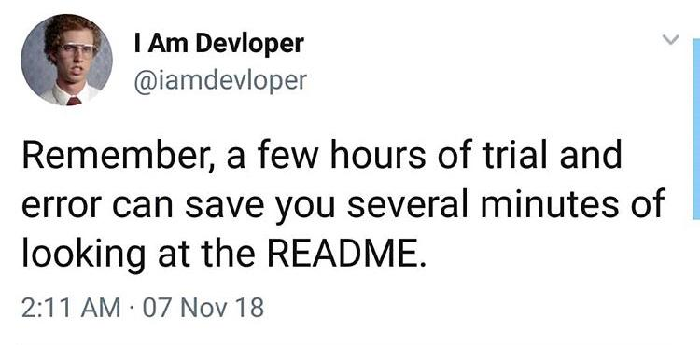
Why README

Slide 12

.gitignore
tells git which file types to ignore
.DS_Store
Library
Temp
*.csproj
*.pidb
*.unityproj
*.sln
*.userprefs
Build
/[Oo]bj/
For Unity

Slide 13
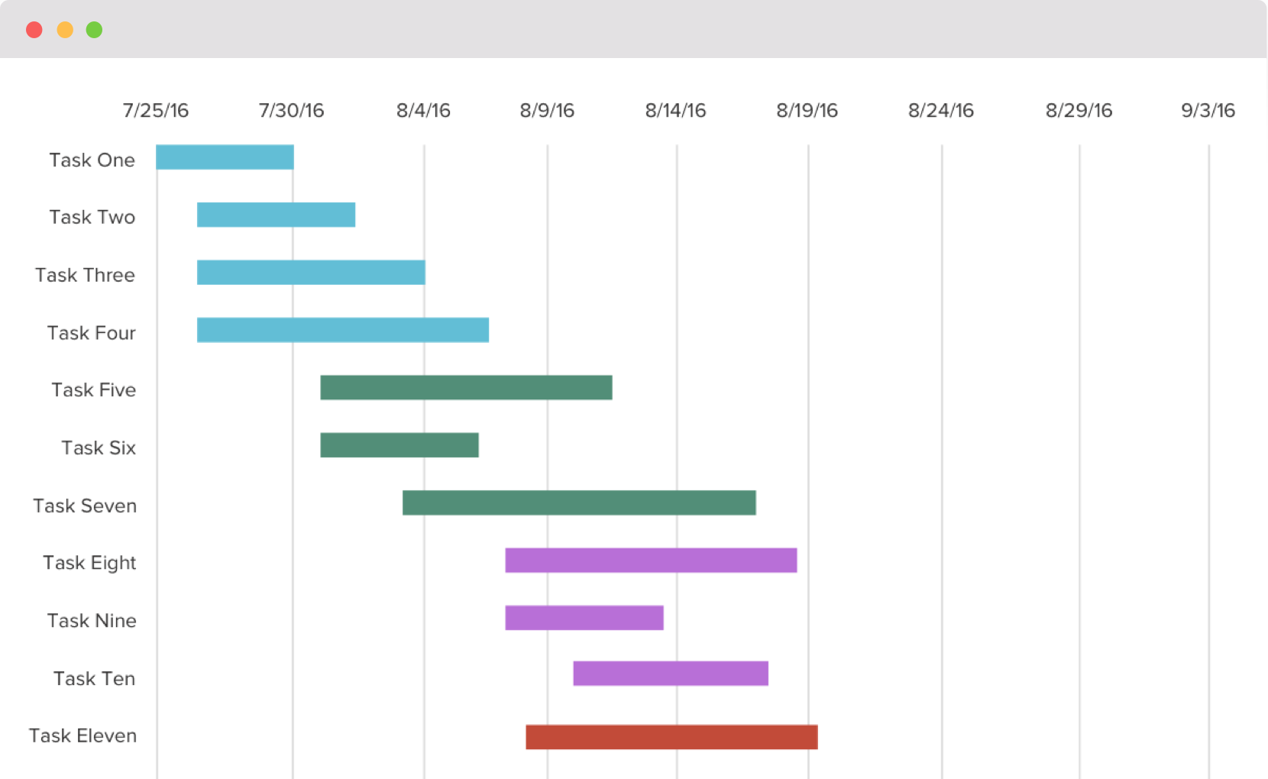
Project Management
Project Timeline
Github Issue Management

Slide 14
Next Week
Homework: Unity & Github Installation
Global Game Jam
Unity Editor (Week 3: Resources)

